Slide 1
Mini Coding Challenge: Getting Web Data w/ Python
2/23/18

Slide 2

Getting Web Data with Python
Why would you want to learn this?
You can automate the collection of very large amounts of data from online sources with Python
Ways it can be done:
Manually parsing HTML (bs4 etc.)
Calling APIs directly
Calling APIs via an API wrapper (tweepy etc.)
http://www.tweepy.org/
https://www.crummy.com/software/BeautifulSoup/bs4/doc/

Slide 3

Getting Web Data with Python
APIs are for programmers to interrogate a data source
Pros:
Data is often obtained in nicely structured formats (JSON etc.)
Many large data repos have them
Cons:
Error handling can sometimes be a pain

Slide 4

Getting Web Data with Python
Today we’re going to use the Requests package to call an API directly
We are going to use toy examples, but keep in mind that APIs for “real” data sources can have a lot of functionality
http://docs.python-requests.org/en/master/

Slide 5

API Call Example
As an example we will call metaweather.com’s API to get a forecast for the Seattle area
Python (3.6)/programming tools we will be using:
Functions
For loops
JSON
Requests package (may need to install)
pprint

Slide 6
API Call Example
The API URL is accessed at https://www.metaweather.com/api/
This API works by accepting different arguments in a base URL that governs a JSON response

Slide 7
API Call Example
The base URL ‘https://www.metaweather.com/api/’ has a location method that takes a ‘where on earth id’ argument
For example, we can enter: ‘https://www.metaweather.com/api/location/2490383’ into a browser to get the forecast for King county(woeid=2490383) in JSON

Slide 8
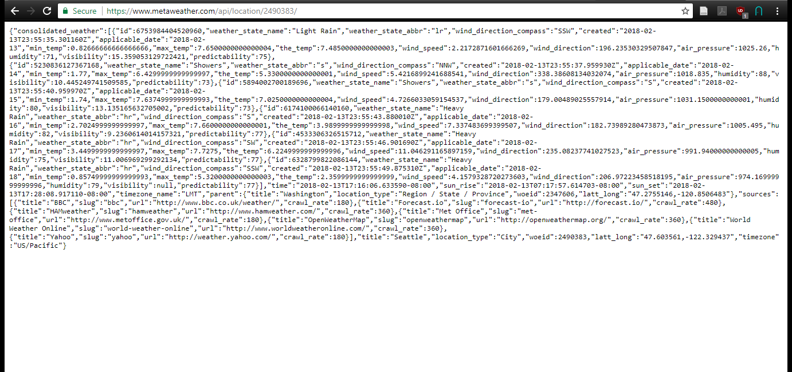

Slide 9
API Call Example
JSON usually looks messy, but we can organize it in python and dig for what we want.

Slide 10
My Mini-Challenge
Make a script that:
Prints the forecasted UV index and corresponding time for Pullman using the EPA’s API: https://www.epa.gov/enviro/web-services#hourlyzip
Or prints common exchange rates for a given currency (i.e. USD) using the API of http://fixer.io/
Or prints the GPS coordinates and username of everyone that was recorded as having flu symptoms in the last day via the API of http://www.flutrack.org/

Slide 11
API Call Example
https://github.com/cougpy212/Mini-coding-challenge-getting-web-data for examples and solutions:
Jupyter notebook files
HTML w/ markup
Python files

Slide 12
Good things to know moving forward
Writing to files (its unlikely you are just going to print your data)
Handle exceptions/check status codes
Identify yourself to the service you are accessing
Throttle requests with the built-in time module

Slide 13
Good Resources
Requests documentation: http://docs.python-requests.org/en/master/
JSON info: https://www.json.org/
JSON lint: https://jsonlint.com/

